Slide 1
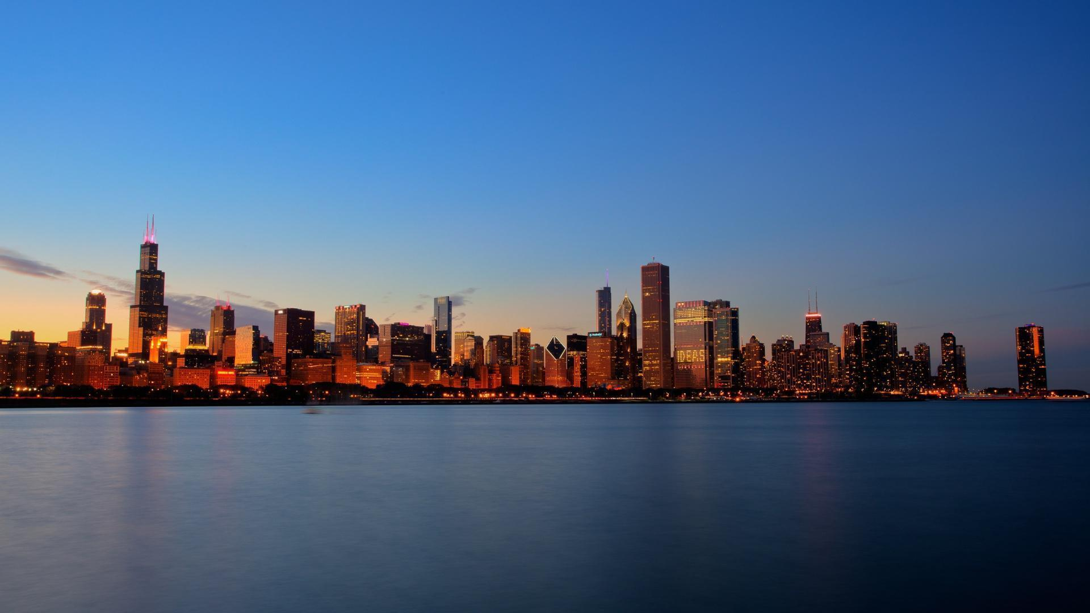
Restaurant diversity in Boston neighborhoods
IBM Data Science Professional Certificate
Capstone Project
Brian Schaefer
April 17, 2020

Slide 2
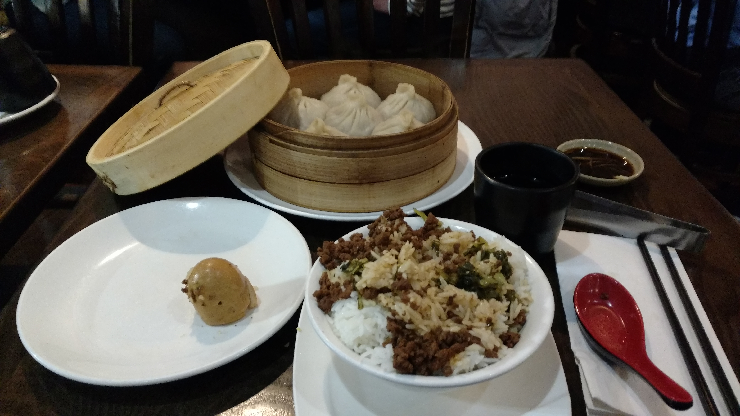
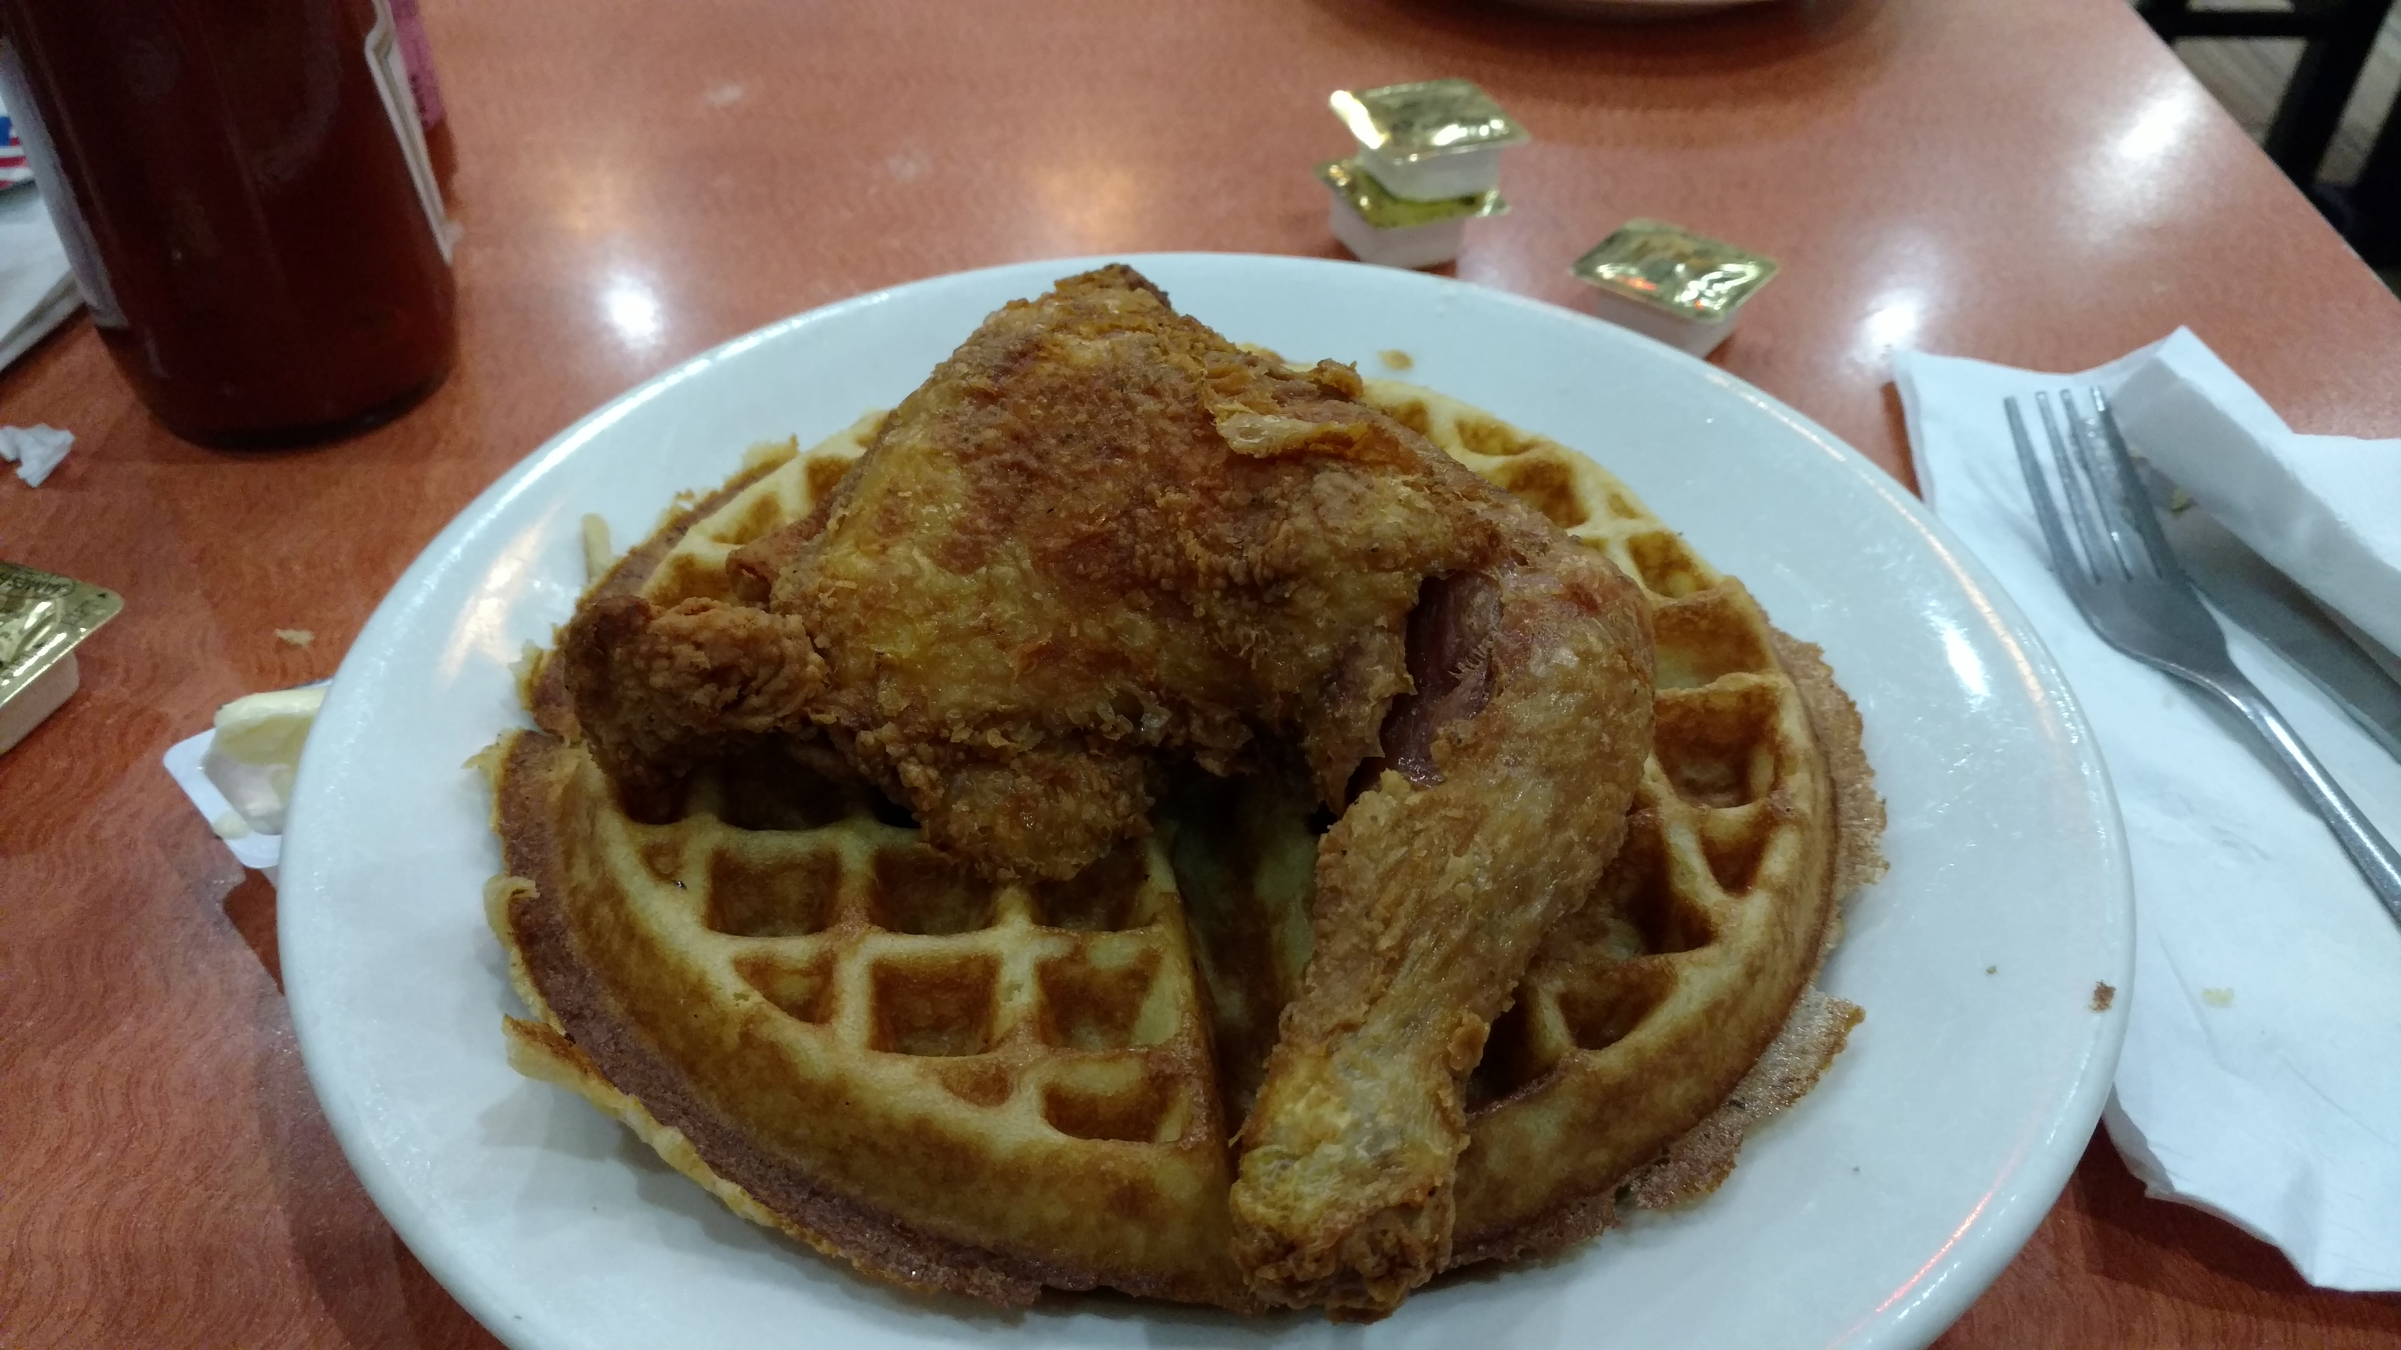
Objective: Find the neighborhoods in Boston with the most diverse restaurants
Where should someone visit or live if they want access to diverse cuisines, like Taiwanese dumplings and Southern fried chicken and waffles?

Slide 3
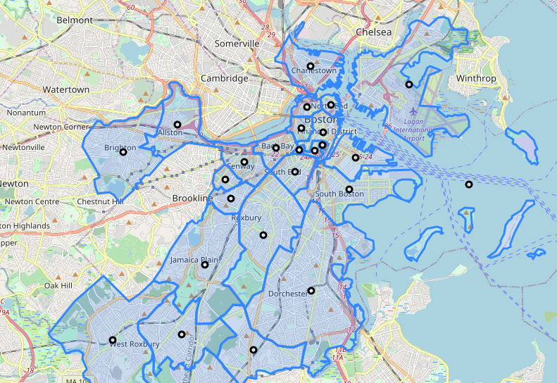
Boston Neighborhoods
Geographical data (GeoJSON format):
https://data.boston.gov/dataset/boston-neighborhoods
Centroids (black) calculated from polygon boundaries

Slide 4


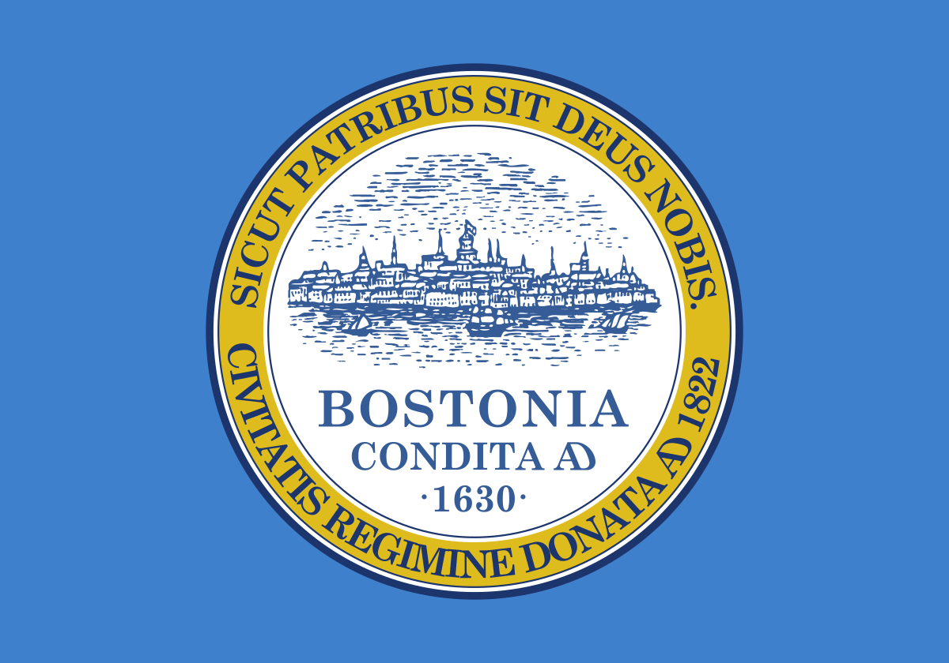
Boston Neighborhoods
Some neighborhoods are known for a particular cuisine:
North End
Chinatown
Seaport District
South Boston
Are restaurants more diverse here?
Geographical data (GeoJSON format):
https://data.boston.gov/dataset/boston-neighborhoods
Centroids (black) calculated from polygon boundaries

Slide 5
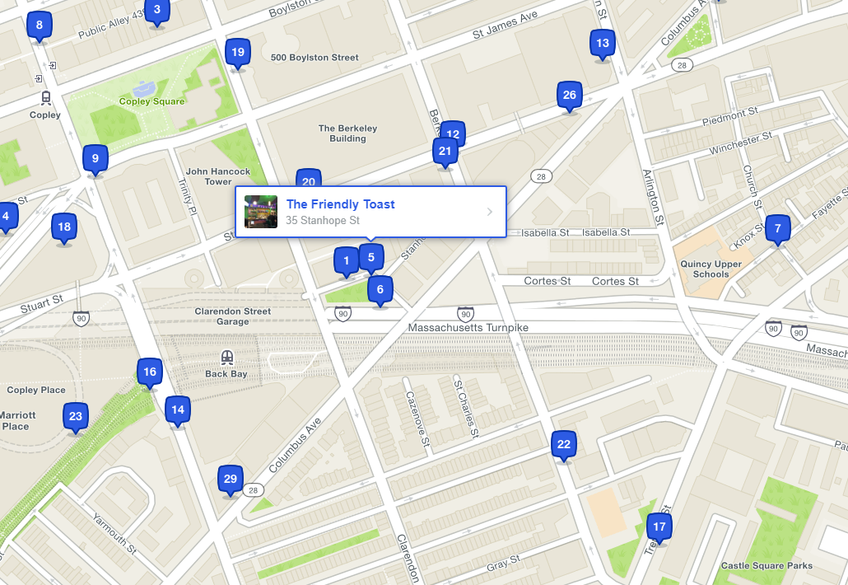
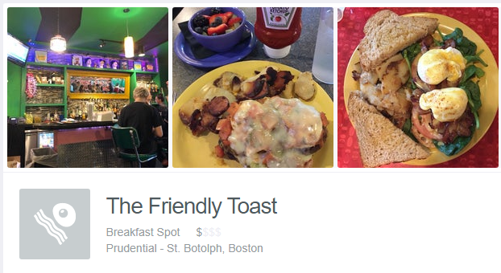

Exploring restaurants
Use the Foursquare API to search for “Food” venues around the geographical centroid of each neighborhood
Information for each venue:
Venue name (“The Friendly Toast”)
Venue category (“Breakfast Spot”)
Geographical coordinates
Address

Slide 6
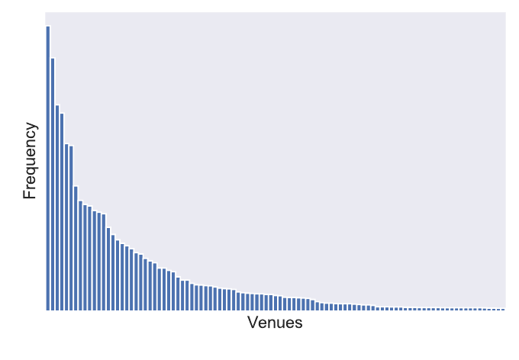
Distribution of venue types in Boston
Pizza place
Coffee shop
Café
Creperie
Noodle House
Wings Joint
…

Slide 7
Diversity index
Define a “diversity index”

